Slide 1

Can You Feel the Beat?
Measuring the quantum beat
Shivam Suthendran (20499543)

Slide 2
Summary of Contents
PREMISE AND MOTIVATION | Building blocks | Block assembly and analysis | results
Indistinguishability | The Photon | Detecting the Quantum Beat | Conclusions
Plan of Attack | Hong-Ou-Mandel (HOM) Experiment | HOM Dip | Future Considerations
 | Second Order Correlation Function |  | Acknowledgements

Slide 3
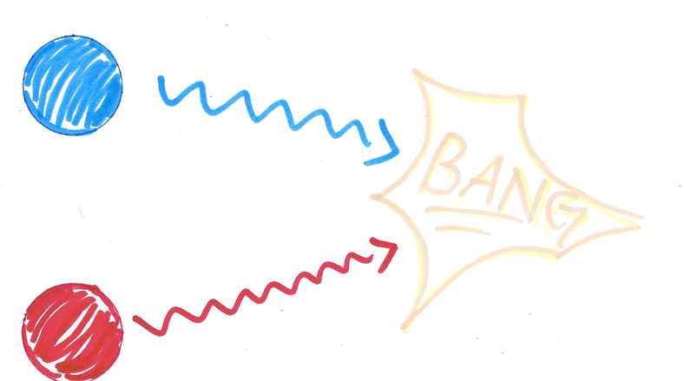
The Question of Indistinguishability
Can you tell me about the final particle trajectories?

Slide 4
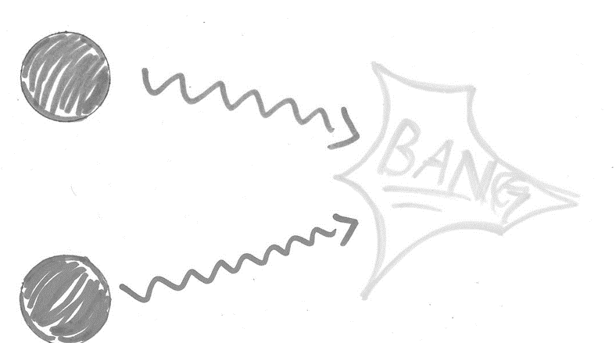
The Question of Indistinguishability
What about now?
And if they were quantum particles?

Slide 5
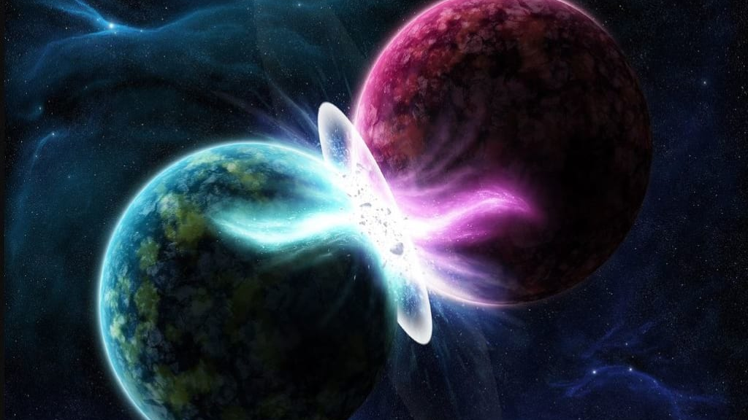
Photon Indistinguishability
Quantum Computing requires the generation of indistinguishable entangled photon pairs
How does one determine photon distinguishability?
https://miro.medium.com/max/1024/1*twIJrqreLpie6__bnqE9rg.png

Slide 6



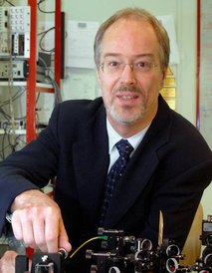
Plan of Attack - Motivation
“Time- Resolved Two-Photon Interference”
by Legero, Wilk, Kuhn, and Rempe (LWKR):

Slide 7
Plan of Attack - Motivation
Demonstrate Quantum Beat
Compare Probability Distributions Found with Idealized HOM Probability Distribution

Slide 8





Plan of Attack - Process
“Signatures of Hong-Ou-Mandel Interference at Microwave Frequencies”
by M. J. Woolley, C. Lang, C. Eichler, A. Wallraff, and A. Blaise (WLEWB)

Slide 9
Plan of Attack - Process
Perform Hung-Ou-Mandel Experiment on Incident Photons
Determine Associated Second Order Correlation Function
Integrate Second-order Correlation Function Over all Possible Detection Times and Detection Delays

Slide 10
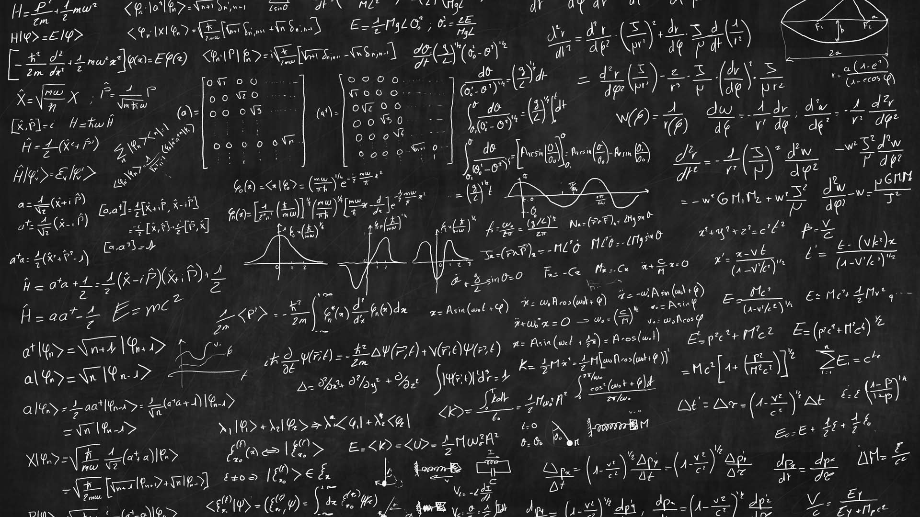



Plan of Attack – What is Needed
Hung-Ou-Mandel Experiment
Second Order Correlation Function
Shape of the Photon
https://www.gettyimages.ca/

Slide 11
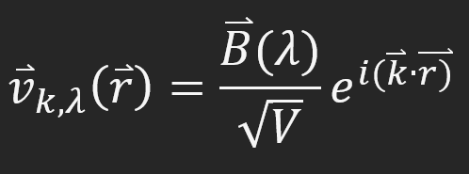
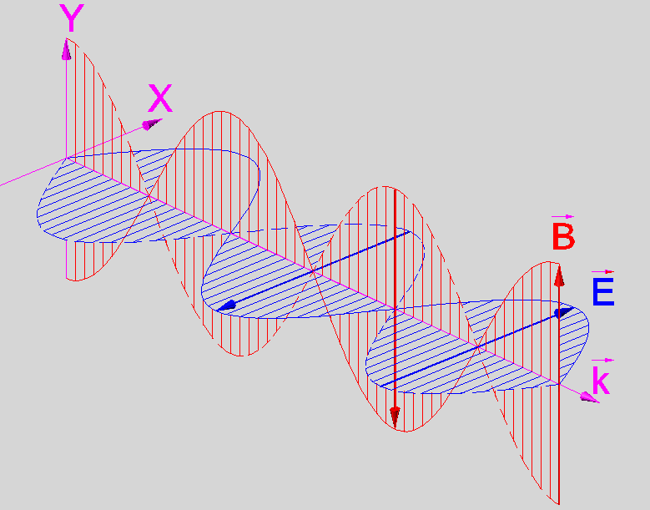
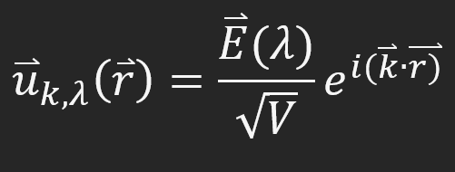
The Photon - 1
Natural fit for the harmonic oscillator framework
But there is a small problem!
This is Polarization Dependent

Slide 12
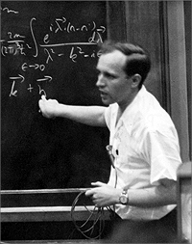
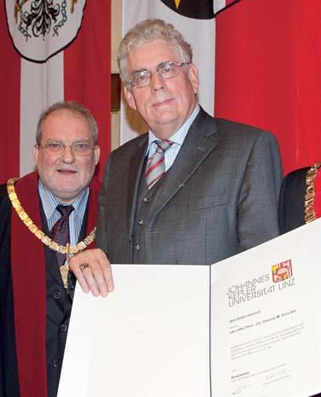
The Photon - 2
“Density Operators of Coherent Fields”
R. J. Glauber and U. M Titulær (GT)
Found Relationship Between:
Inverse Lifetime of Photon
And
Spectrum of Frequencies
Gave Rise to Temporal Mode Functions

Slide 13
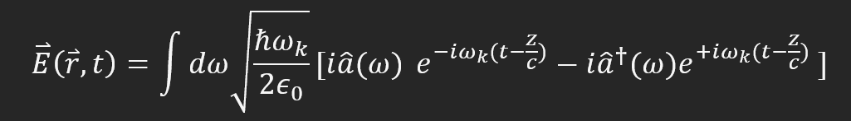
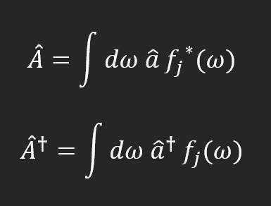
Temporal Mode Functions - 1
Suppose we assume the following form:
Creation and annihilation operators generate and destroy frequencies
We can assume a wave packet can be created or annihilated with a linear combination of these frequencies

Slide 14
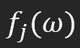
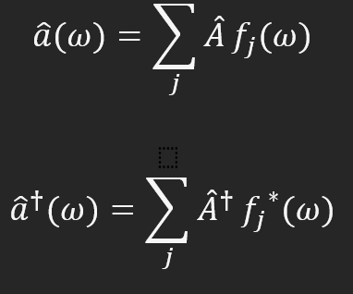
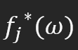
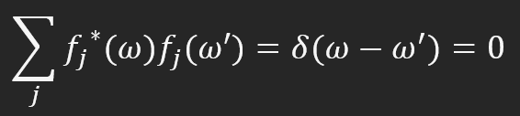
Temporal Mode Functions - 2
These are orthogonal weight functions
Modify the creation and annihilation operators
Orthonormal set that are complete and follow this relationship :

Slide 15
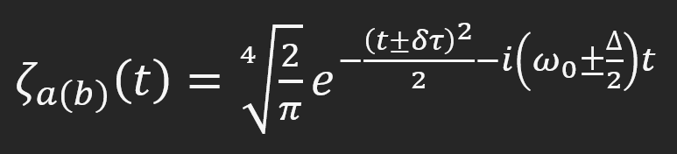
The Photon - 3
Mode Function Defined by LWKR

Slide 16

The Photon - 4
$δτ$ is the temporal separation between photons
$ω_{0}$ is the central frequency between photon a and b
$∆$ is the frequency difference between photons a and b

Slide 17
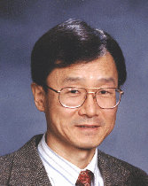
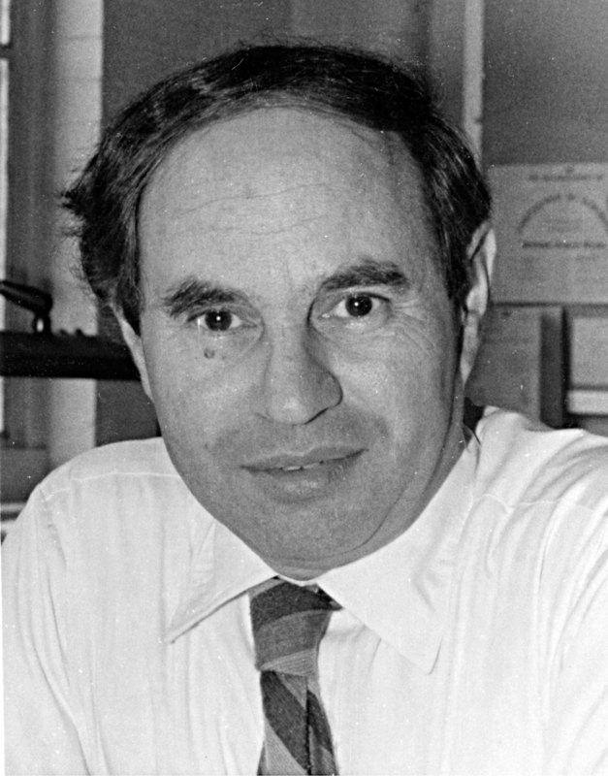

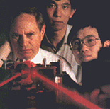
The HOM Experiment - 1
Conceived by Chung Ki Hong, Zheyu Ou, and Leonard Mandel in 1987
Landmark Experiment in Quantum Optics

Slide 18
The HOM Experiment - 2
Two Photons are Incident Upon a Beam Splitter
Output Beams are Incident Upon a Photodetector
Delay between Detections Measured

Slide 19
The HOM Experiment - 3
Found that if there was no temporal separation and the photons were indistinguishable – Coincidence counts were nonexistent
Purely Quantum Effect!
https://www.mdpi.com/1424-8220/20/12/3475/htm

Slide 20
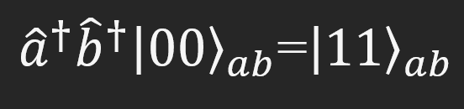
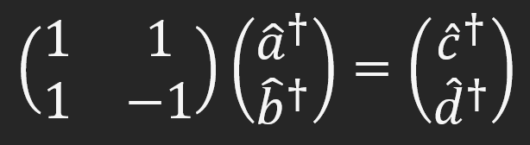
The HOM Experiment – The Math - 1
Photon Creation – Creation Operators Acting on Vacuum State
Beam Splitter Transformation – From Input Photons a and b to Output Photons c and d

Slide 21
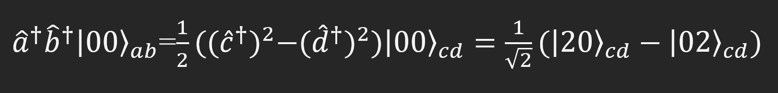
The HOM Experiment – The Math - 2
Final Result of the HOM Experiment – No Coincidence Counts!

Slide 22
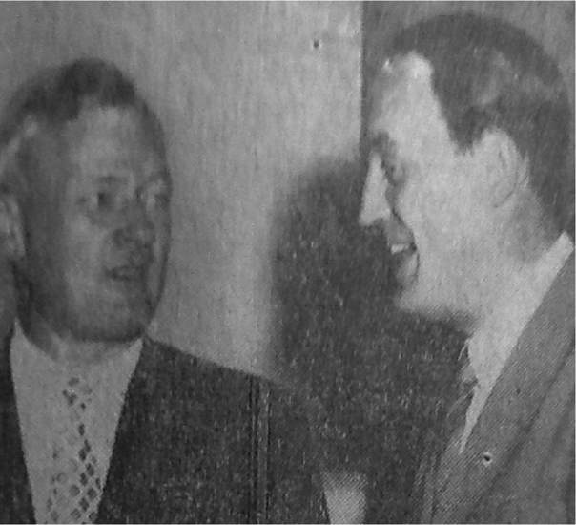
The Second Order Correlation Function
Motivated by the Experiments of R. Hanbury-Brown and R. Twiss
Wanted to Prove that a Beam Splitter was Sufficient to Determine Star Size
Found that Intensity was Proportional to Current Fluctuations

Slide 23
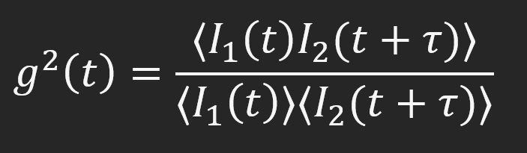
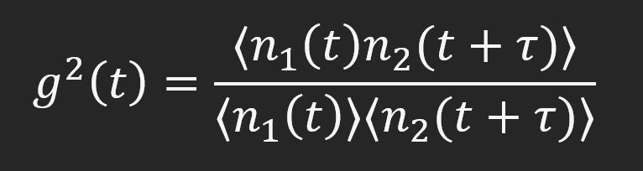

Second Order Correlation Function – $g^{2}\left(t\right)$
Output Modelled via Second Order Correlation Function
In Quantum Optics, Photon Counting Used Rather than Intensity

Slide 24

Now Let’s Build!

Slide 25
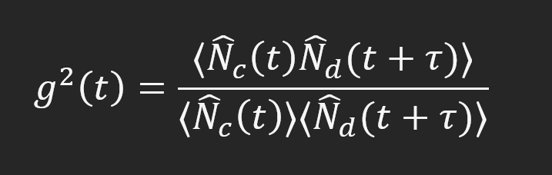
Detecting the Quantum Beat - 1
Develop second order correlation that represents HOM effect
Function shown previously considers input interactions
Slight change for output interactions of photons c and d

Slide 26
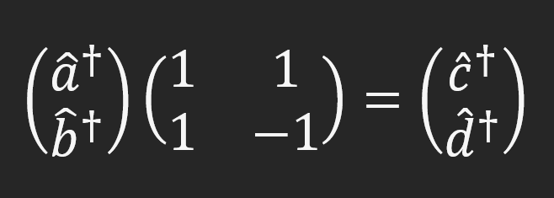
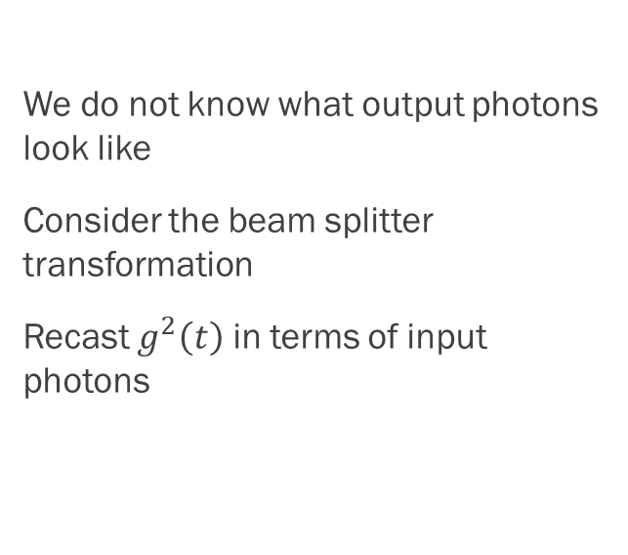
Detecting the Quantum Beat - 2
We do not know what output photons look like
Consider the beam splitter transformation
Recast $g^{2}\left(t\right)$ in terms of input photons

Slide 27
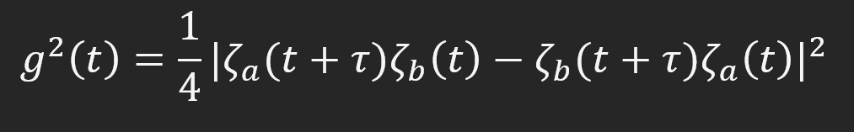
Detecting the Quantum Beat - 3
Simplifications:
Only considering single photon emissions
Time dependence only in the temporal mode function
Use of vacuum state
Expectation of number operator on first excited state is 1

Slide 28
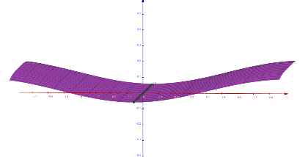
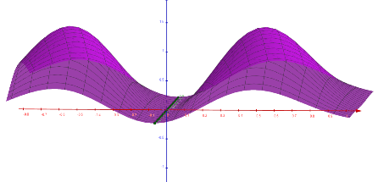
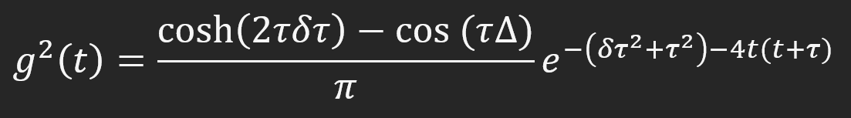
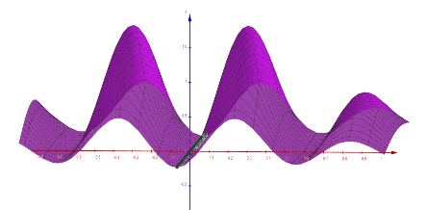

Graphing the Quantum Beat
We can graph this $g^{2}\left(t\right)$ over different frequency differences
$∆$ = 0
$∆$ = $\frac{3}{2}π$
$∆$ = $3π$
As frequency increases so too do the number of fringes within the envelope

Slide 29
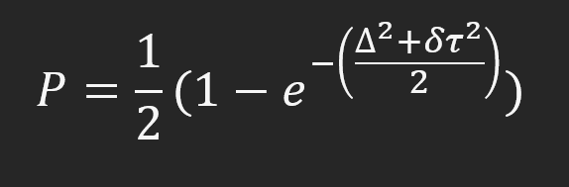
HOM Dip - 1
Integrate over all detection times and
detection delays
Gives Probability Distribution of all Possible Detection Delays
Contrast it with Idealized HOM Dip

Slide 30
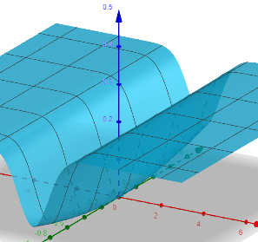
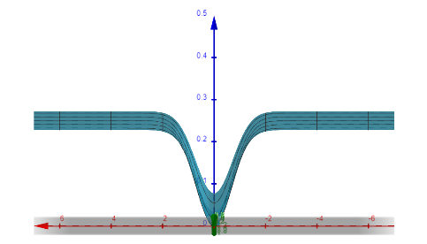
HOM Dip - 2
We graph the probability distribution
Notice the rise in the HOM Dip as frequency difference becomes larger
2nd Confirmation of Photon Distinguishability

Slide 31

Summary of Results
Confirms the use of HOM experiment as verification of Photon Indistinguishability in the Frequency Domain
Presence of Quantum Beat when graphing 2nd Order Correlation Function
Rising of HOM Dip as Frequency Difference is Changed
https://www.thoughtco.com/what-is-a-photon-definition-and-properties-2699039

Slide 32

Future Considerations
Industry Standard is Spontaneous Parametric Down Conversion
Seeks to move away from this through Quantum Dot
Test Reimer Group’s Quantum Dot using HOM Experiment
Measure Distinguishability of Generated Photons
https://www.oxfordmartin.ox.ac.uk/future-computing/

Slide 33
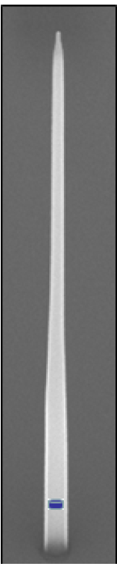
Quantum Dot
Quantum dot consists of two V-III Semiconductors
InP
InAsP
Nanowire made up of InP
Quantum Dot itself InAsP

Slide 34
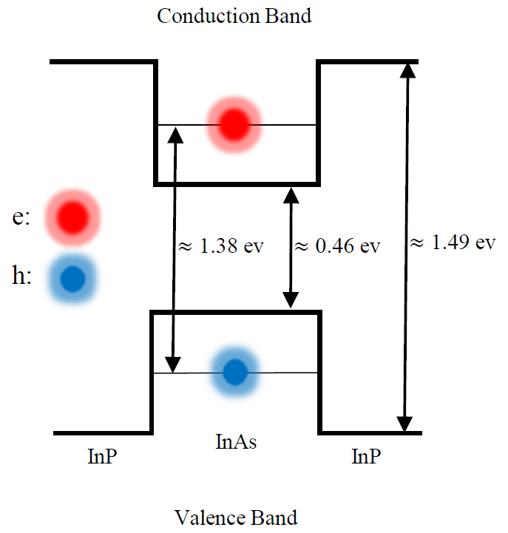
Using the Quantum Dot
Mode Used is 2 Photon Resonant Excitation
Light hits the nanowire which excites electrons into conduction band
Upon Recombination Electrons and Holes Fall into Quantum Dot

Slide 35
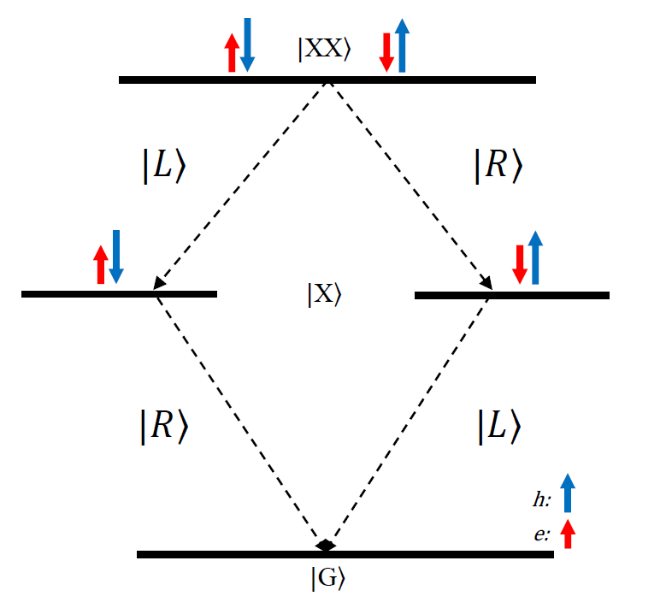
What about 2?
General Process uses Exciton-Biexciton Cascade
2 Electron-Hole Pairs in Quantum Dot
Energy Transition from Biexciton to Exciton dictates energy of emitted photon

Slide 36
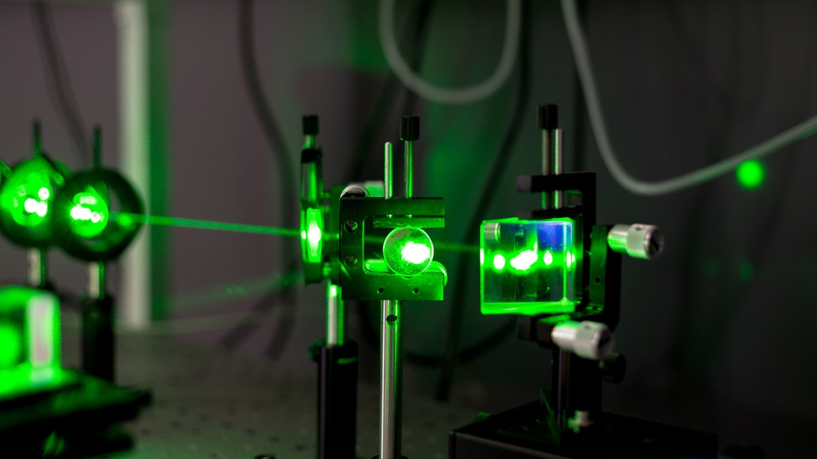
Products of Quantum Dot
Nanowire made such that only one frequency mode is allowed
Taper allows for smooth transition of photon into free space
This is then collected into optical cables for experimentation
Emits Photon with a Voigt Profile
https://www.azooptics.com/Article.aspx?ArticleID=1502

Slide 37

Acknowledgements
Dr. Michael Reimer for his kind, gentle, and informative supervision

Slide 38
Acknowledgements
Dr. Michael Reimer for his kind, gentle, and informative supervision
The Quantum Photonics Devices Group for Their Support of My Partaking in Group Meetings and Invaluable Feedback

Slide 39
Acknowledgements
Dr. Michael Reimer for his kind, gentle, and informative supervision
The Quantum Photonics Devices Group for Their Support of My Partaking in Group Meetings and Invaluable Feedback
Particularly Sonell and Matteo for Teaching Me How to Find Resources and Use Them Effectively

Slide 40
Acknowledgements
Dr. Michael Reimer for his kind, gentle, and informative supervision
The Quantum Photonics Devices Group for Their Support of My Partaking in Group Meetings and Invaluable Feedback
Particularly Sonell and Matteo for Teaching Me How to Find Resources and Use them Effectively
And My Husband, Friends, and Family; Without Whom I Would’ve Given Up Long Ago

Slide 41

Thank You for Your Time and Consideration

